Slide 1
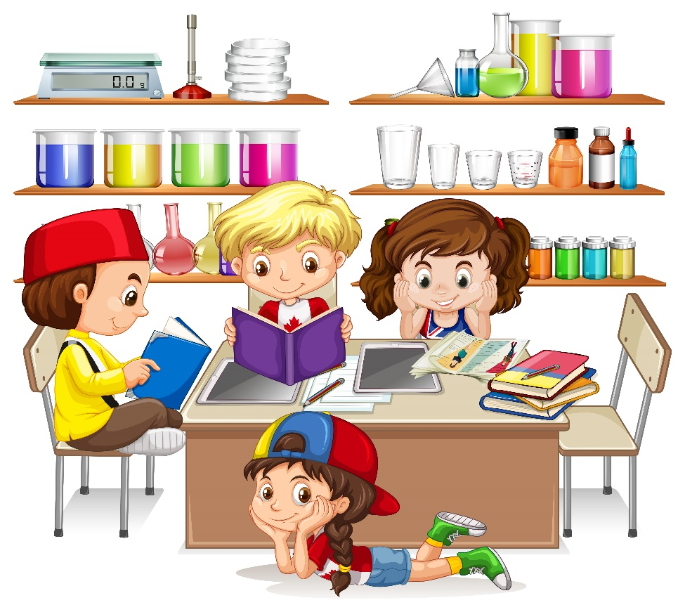
Foundation Stage
The Bahá’í Faith
Notes:
Picture Attribution to: <a href="https://www.vecteezy.com/free-vector/isolated">Isolated Vectors by Vecteezy</a>
Note to teachers: If this is the first time that you are using these Bahá’í materials, it is recommended that teachers read the introduction to understand how to use the materials.
We appreciate your feedback about these materials as it helps us to improve these materials. Please visit: https://forms.gle/ufrRvFVFCKH3XFcs8

Slide 2

Topics
Press for topic
  Who is special in the Bahá’í Faith?
  Why is togetherness important?
  What places are special for Bahá’ís?
  What times of the year are special
  for Bahá’ís?
  Children in the Bahá’í Faith
  How do Bahá’ís see the world and care for it?
Press for topic
Press for topic
Notes:
Picture Attribution to: https://www.cleanpng.com/png-question-mark-clip-art-question-mark-images-180139/

Slide 3
  Who is special in the Bahá’í Faith?
Notes:
Picture Attribution to: https://www.cleanpng.com/png-question-mark-clip-art-question-mark-images-180139/

Slide 4



The Bahá’í Faith
Nine pointed star - A Bahá’í symbol
Baháʼí
Bahá'u'lláh
Notes:
Who is special in the Bahá’í Faith?
Today we are going to look at the Bahá’í Faith. (Have the children practice saying Bahá’í as it is a tricky word). Bahá’ís believe in God and they follow the teachings of Bahá'u'lláh (again, this is a tricky word so they can practice saying it using the link below). Bahá'u'lláh taught people about unity or togetherness. Let’s explore what unity means:

Slide 5
  Why is togetherness important?
Notes:
Picture Attribution to: https://www.cleanpng.com/png-question-mark-clip-art-question-mark-images-180139/

Slide 6
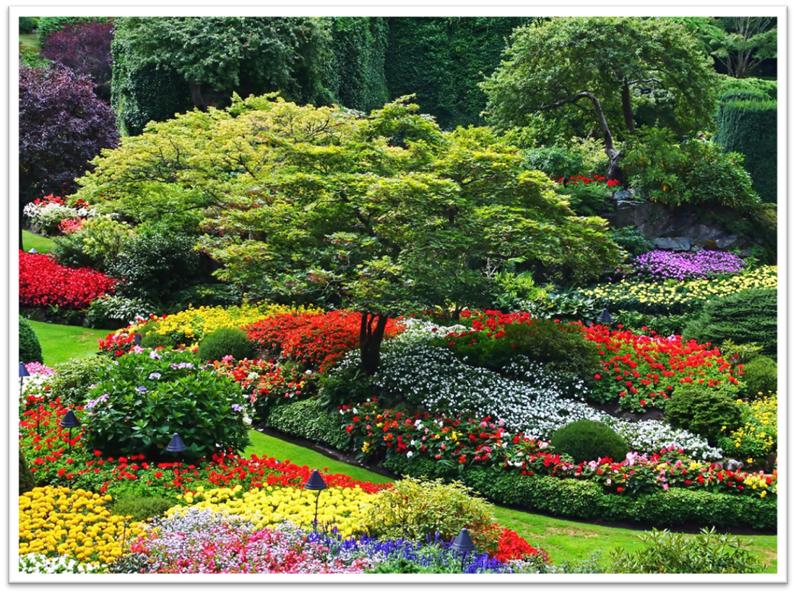
We are like the flowers of a garden.
Notes:
Why is togetherness important?
Bahá'u'lláh said ”Ye are the flowers of one garden.” The word ‘ye’ is old English for ‘we’. So this means ‘we’ (people) are like the flowers of one garden. Let’s explore what this means...
Picture Attribution to: "Butchart Gardens Fairytale" by WisDoc is licensed with CC BY-NC-ND 2.0.

Slide 7
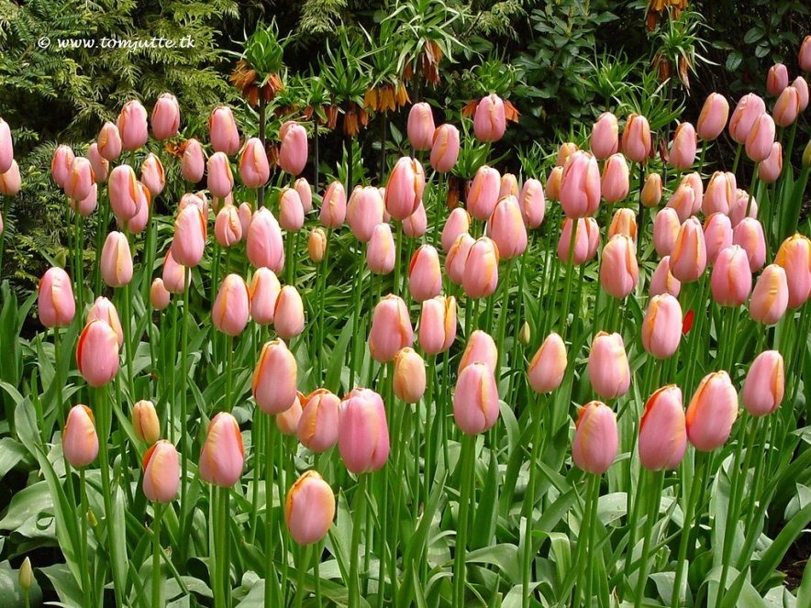
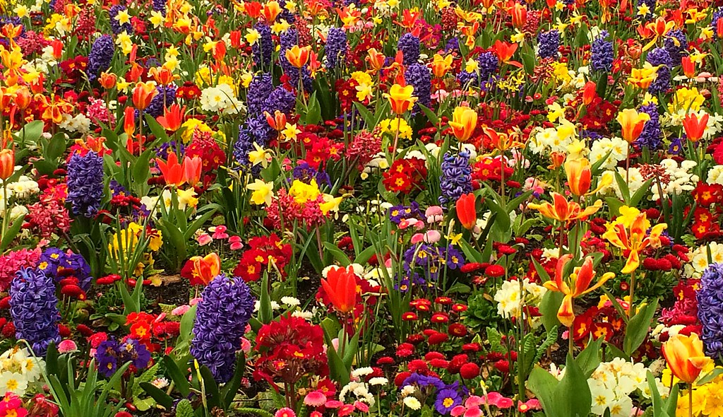
Which garden do you think is prettier?
Notes:
Do you think it's prettier to have a garden with only one type of flower in only one colour or is it more beautiful to have a garden with many different flowers of different colours?
Do you agree that the garden with many different flowers and different colours is more beautiful? Why do you think that is? Maybe because it’s kind of boring to have a garden with just one type of flower or one colour, don’t you think?
Picture Attribution to: "Dutch Tulips, Keukenhof Gardens, Netherlands - 3928" by HereIsTom is licensed with CC BY-NC-ND 2.0. To view a copy of this license, visit https://creativecommons.org/licenses/by-nc-nd/2.0/
Picture Attribution to: "Burst of Spring colour" by natzweb is licensed with CC BY 2.0.

Slide 8
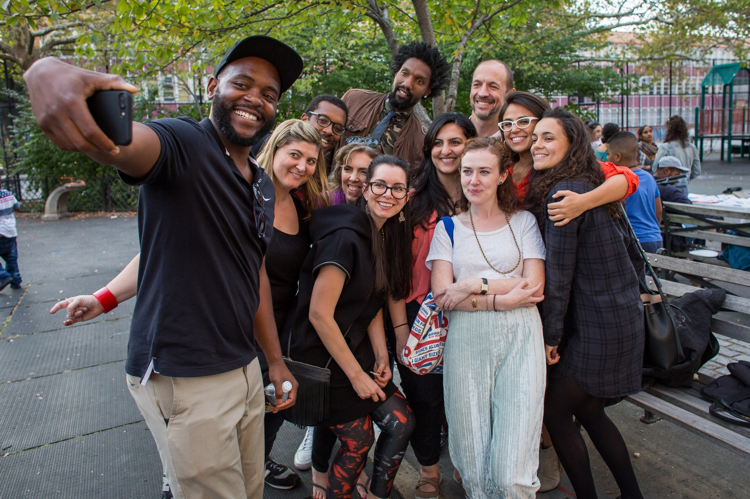
How are people different?
Notes:
What about people? Do all people look the same? No! What are some ways that people are different? (Explore this with the children: different hair colour, eye colour, skin colour; we might be short or tall, etc. )
That's why it is important to accept everyone just the way they are. Because if everyone were the same, the world would be pretty boring, right?
Picture Attribution to: www.bahai.us

Slide 9

The World’s Family
Notes:
This is a video which shows how people can be different, why it’s good to be different and what people can do when everyone works together.
https://www.youtube.com/watch?v=ni_at59TzMA
Video Attribution to:
Creator’s name or screen name Candyseed Stories
Video title The World's Family (An Embracing Culture Story) kid's /children's podcast
Video URL Https://www.youtube.com/watch?v=ni_at59TzMA
Website name Artful4.com
Publication date: Jan 27, 2015

Slide 10
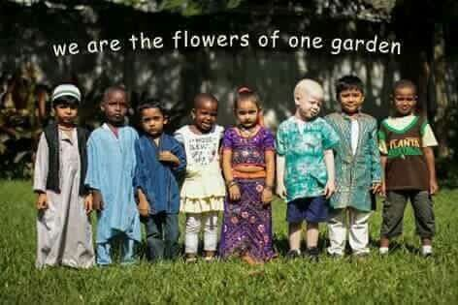
For activities press
Notes:
So will you remember that? Being different is a way of making the world more beautiful.
It’s important to try to understand and like people who are different from us. If everyone does this, then fighting will stop and people can live together in peace. Because it is everyone’s differences that makes the world an interesting and special place.
Activity 1: Create a class garden. Draw your favourite flower or tree. You can even make one up like a love heart tree. Put your name on it and glue everyone’s picture to A1 green card. Write ‘We are all the flowers of one garden’ on it to remind the children that their differences make them a beautiful garden.
Activity 2: Paint handprint flowers and garden. Make a class garden. Everyone gets to dip their hand in paint and make their handprint on one big piece of white A1. The teacher can add stems or grass at the bottom. See pic.
Activity 3: Create tissue paper flower collages. See attached template
Activity 4: Flowers of One Garden Colouring Sheet

Slide 11
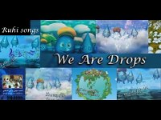
Notes:
Here is a song about unity and togetherness:
Teacher’s notes: This song can be used with hand movements. If you wish you can be creative and ask the children to help pick hand movements for certain words in the song.
https://www.youtube.com/watch?v=qsDHH5T5B5M – We are drops
Video Attribution to:
Creator’s name or screen name: bahainafeza
Video title: Song We are drops
Video URL: https://www.youtube.com/watch?v=qsDHH5T5B5M
Music from: www.ruhi.org/resources/songs.php
Publication date: Apr 16, 2015

Slide 12
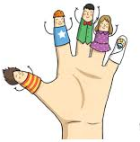
The Rule of Thumb
For activities press
Main menu
Next topic
Notes:
This is a story which shows how people can be different, why it’s good to be different and what happens when everyone works together.
Teacher notes: It’s good to prepare for the story and be ready to act it out as you read it. Feel free to use props such as finger puppets or draw faces on each finger and thumb. Also have a heavy book, bottle of water, and a pencil so that you can really demonstrate how necessary it is for your thumb to help pick up, open and write. Children can be encouraged to use their hands to act out the story with the teacher.
The Rule of Thumb
Once there were four fingers on a hand. One was tall, two were medium-sized, and one was a small fellow. But aside from this they were all much alike. They faced the same way and stood in a nice row. In a word, they were the “same”.
On the other hand -- no -- on the some hand -- was a thumb. But how different he was! The fingers that were the “same" would get terribly upset at him. “You’re not a real finger! Why can’t you be the same like us?"
They would complain: "We face and move this way but you face and move that way.”
“But I can’t help it,” whined Thumb. "I was made this way; I grew out of the side of the hand and not out of the end like you.”
“Well, ok,” they cut in, "but we all have three joints and you only have two.”
"Now, not quite so fast,” said Thumb. "I have only two that you can see, but inside the hand is a third big joint covered with a large muscle that makes me strong. If it were not for this I wouldn't be able to move like this… and this… and even get close to you like this…”
"Oo… ooh! Go back to your place. It’s clear now that we are better than you; we are high and you are low. We were created apart from you. Our ways are different than yours. You are strange and different. Now let us stay apart.”
Poor Thumb felt so lonely and left out. He cried and cried. “Why am I so different? Why must I always be left out? Surely, since I was created, I must be good for something.”
But the four fingers just left him out. The fingers worked in a group to pick up pieces of paper and other small things that were not too heavy, but when it came to writing with a pencil or lifting something heavy, or opening a jar-lid, or other more difficult work, they weren’t able to do it at all.
And down below, poor lonely Thumb just couldn't do anything at all by himself.
One day the four fingers had to pick up a heavy book. No matter how hard they tried they couldn't do it. After a long time talking among themselves they finally let their pride die a little bit. They looked sheepishly over at Thumb. “Thumb! ... uh…could you … give us a hand – we mean a finger – or a thumb?”
“Sure!” shouted Thumb with glee. Up he jumped and put himself against one side of the book while the four fingers held to the other side. All five fingers now easily lifted the book. The four fingers realized now that he was as strong as the four of them put together.
Thumb began to be accepted by the four fingers. Together they opened and closed things, wound up things, rolled up things, twisted and turned things, held onto things, lifted things and wrote things.
“Well,” said the four fingers, “we think the thumb is a really great after all and we can’t live without him!”
Activity 5: Have the children trace their hand, trace each other’s hand and decorate the hand. (They can make rings, bracelets, colourful nails, zombie hands, love hearts, etc).

Slide 13
  What places are special for Bahá’ís?
Notes:
Picture Attribution to: https://www.cleanpng.com/png-question-mark-clip-art-question-mark-images-180139/

Slide 14
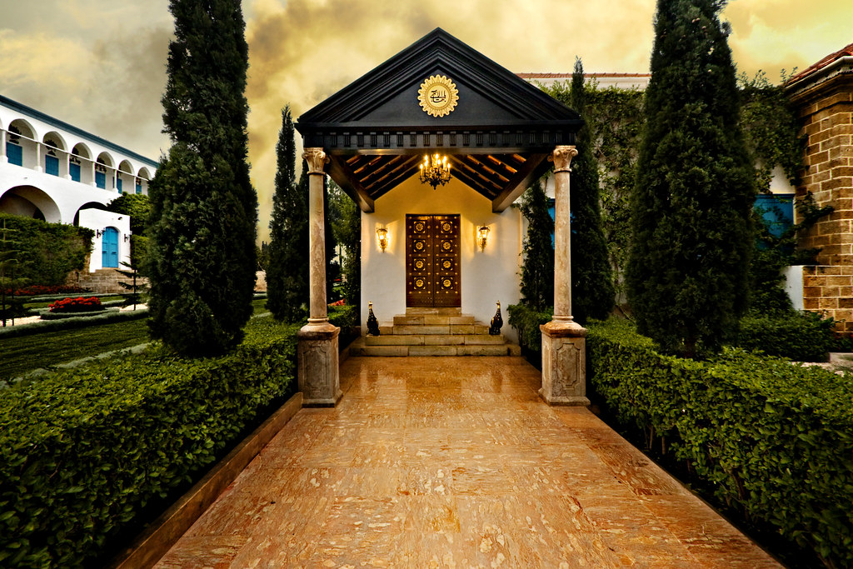
Bahá’í Holy Places
Shrine of Bahá’u’lláh
Notes:
What places are special for Bahá’ís?
This is where Bahá'u'lláh is buried. It is called a shrine.

Slide 15
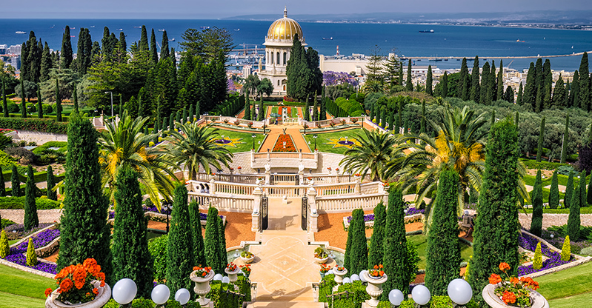
Bahá’í Gardens
Notes:
This is another shrine. It is famous for its gardens and this is located at the Bahá’í World Centre.

Slide 16
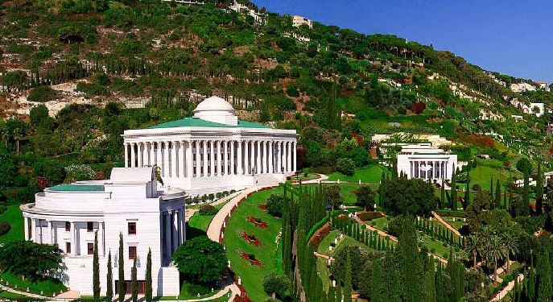
The Bahá’í World Centre
Notes:
This is a picture of the Bahá’í World Centre. It is in Israel.
Bahá’ís from all over the world go there to visit. This is called a pilgrimage. Pilgrimage is a very special time for a Bahá’í.
Bahá’ís say prayers in the shrines.

Slide 17
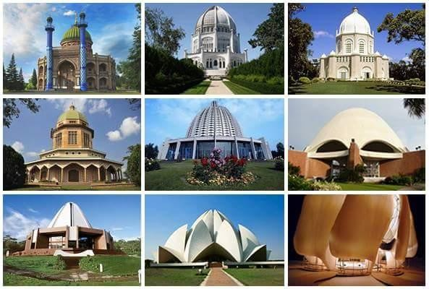
Bahá’í Houses of Worship
Notes:
There are also special Bahá’í Temples called Houses of Worship.
They have nine sides and nine doors are open to people of all religions.
The nine sides show that there are many paths to God and that all religions lead to Him.

Slide 18
  What times of the year are special
  for Bahá’ís?
Notes:
Picture Attribution to: https://www.cleanpng.com/png-question-mark-clip-art-question-mark-images-180139/

Slide 19
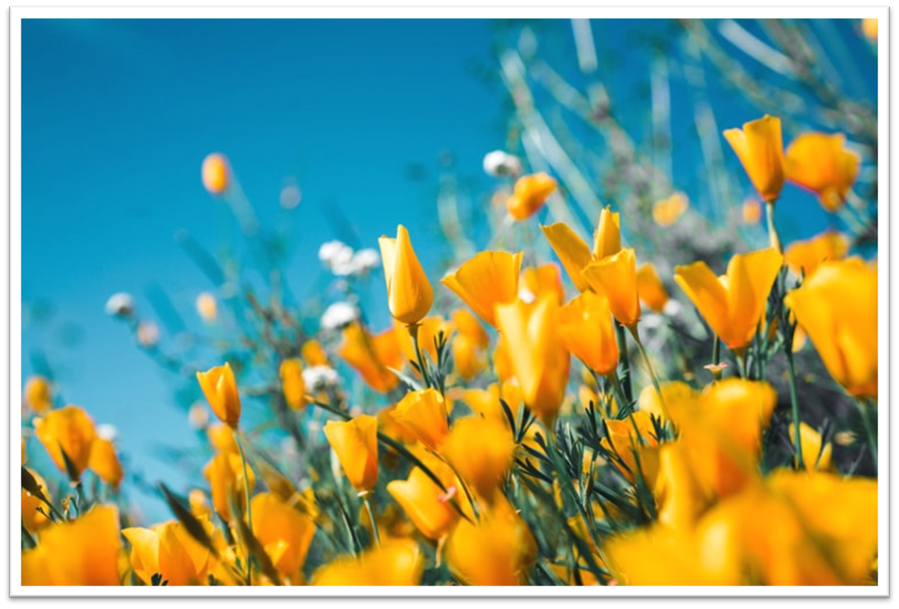

Bahá’í Celebrations
Naw Rúz
Naw Rúz
Notes:
What times of the year are special for the Bahá’ís?
Bahá’ís celebrate Naw Rúz. It is the Bahá’í New Year.
It begins on the first day of Spring, either 20th or 21st of March.
Naw Rúz in Persian means ‘New Day’.

Slide 20
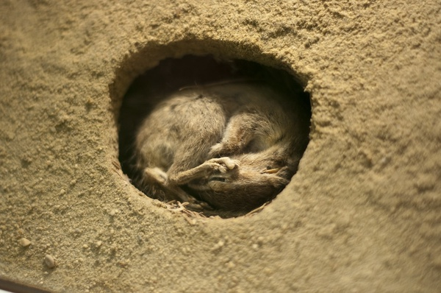
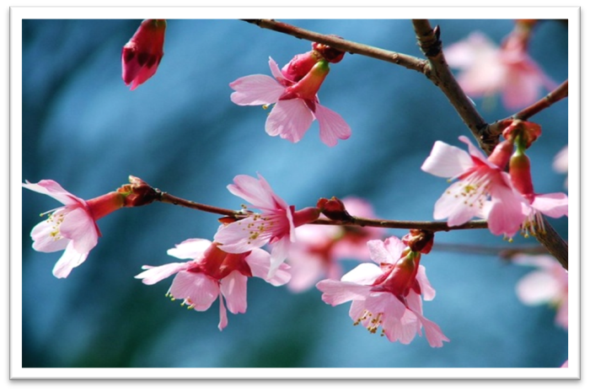
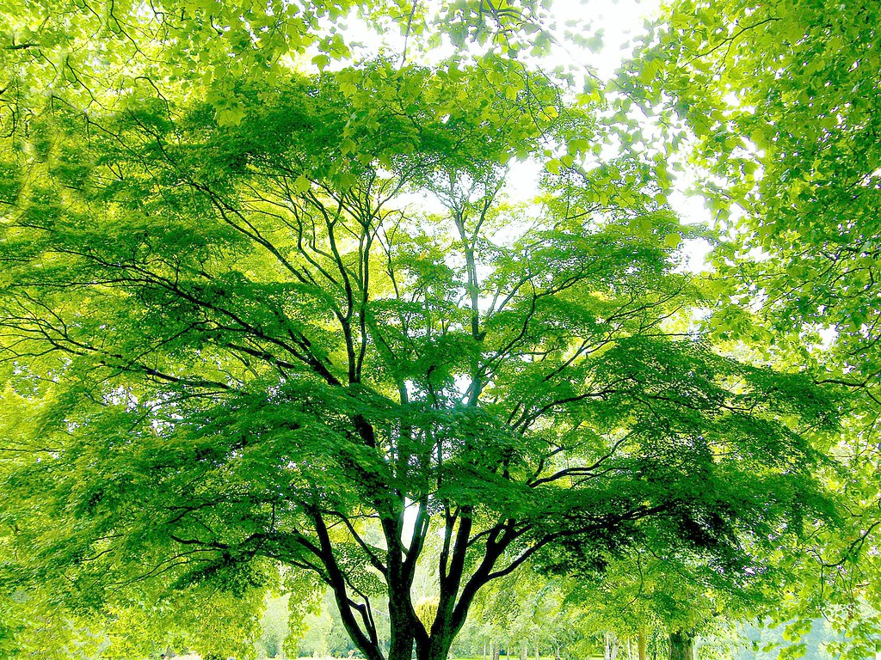
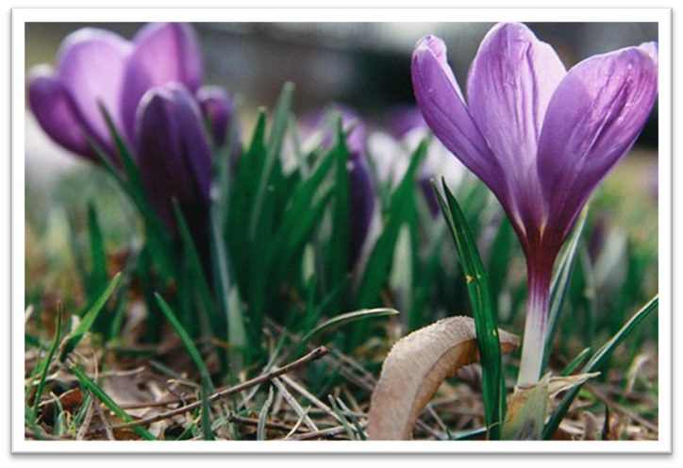
Why do Bahá’ís celebrate their new year on the first day of spring?
Notes:
Why do Bahá’ís celebrate their new year on the first day of spring?
Spring is one of the most important seasons in the year because it's when everything in nature starts to grow.
It's when the animals that were sleeping during winter wake up.
It's when all the flowers start to appear.
All the tree starts growing new green leaves.
In a way, it's like everything in nature is born again because they come out.
Bahá’ís believe that this is a really special thing and that's why they also celebrate the new year with the new life that is appearing around us.
Picture Attribution to:
"Chipmunk Hibernation" by Riebart is licensed with CC BY 2.0.
"Pink Spring Blossoms" by Creativity+ Timothy K Hamilton is licensed with CC BY-NC-ND 2.0.
"Beautiful Green Spring Tree" by Stanley Zimny (Thank You for 52 Million views) is licensed with CC BY-NC 2.0.
"First spring flowers" by barnimages.com is licensed with CC BY 2.0.

Slide 21
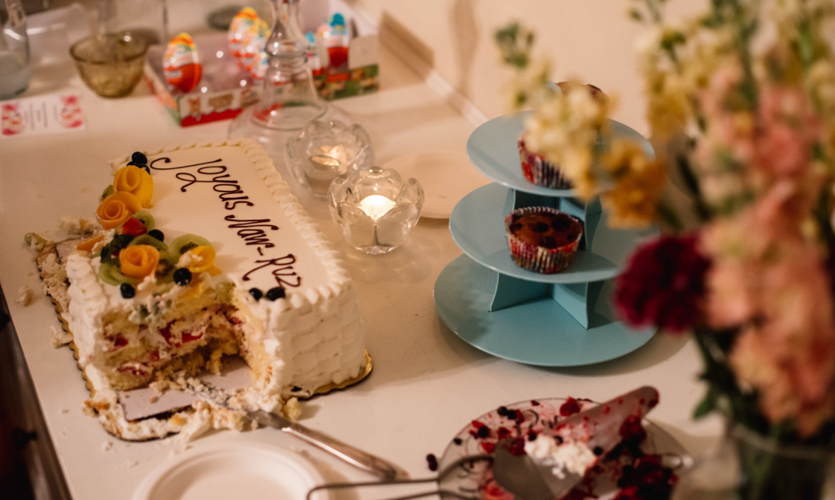
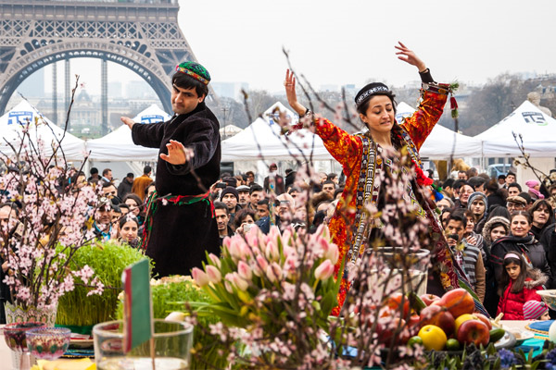
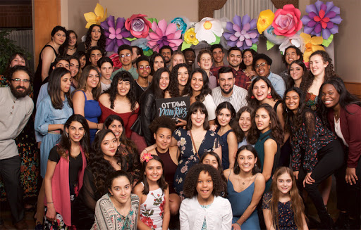
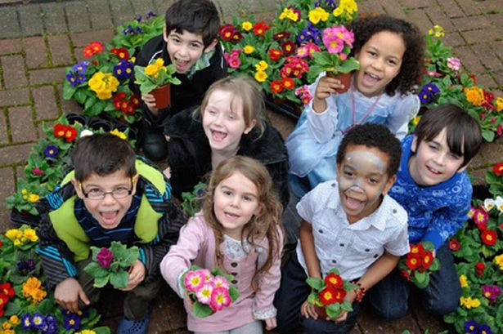
Naw Rúz Celebrations
For activities press
Notes:
Naw Rúz is celebrated by Bahá’ís all over the world. So it is celebrated in many different ways depending on where people come from.
Naw-Rúz celebrations include prayer, music, dancing and visits to friends and family and sometimes giving and receiving gifts.
Activity 6: Artwork – Fingerprint tree
Using the Naw Rúz tree template, create a fingerprint tree using stamp pads or paint. Children are free to draw and add extra ideas about spring to the picture.
Activity 7: Happy Naw Rúz Colouring Sheet

Slide 22
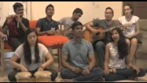
Naw Rúz Video
Main menu
Next topic
Notes:
This is a Naw Rúz song sung by the Bahá’ís in Malaysia.
https://www.youtube.com/watch?v=qFNNlfZ8tzI
See words for the song:
GALA RHYME
There’s one day that’s filled with so much joy.
See the stars fill with smile
To my friends I sing this to them
Com around catch the sound
People of Bahá celebrate this joyful time
Hear the ha ha ha, it’s the gala rhyme
Can you see the harmony
Can you see the fellowship?
Can you see the love, ‘cause it’s Naw Ruz
Repeat
Happy Naw Ruz I wish to you
Happy Naw Ruz you wish me back
Happy Naw Ruz everyone
It is Naw Ruz
It is Naw Ruz
It is Naw....... Ruz!
Video Attribution to:
Creator’s name or screen name Bahai MusicChannel
Video title: Nawruz Song | Gala Rhyme
Video URL https://www.youtube.com/watch?v=qFNNlfZ8tzI
Website name: Bahai MusicChannel
Publication date: Mar 20, 2016

Slide 23
  Children in the Bahá’í Faith
Notes:
Picture Attribution to: https://www.cleanpng.com/png-question-mark-clip-art-question-mark-images-180139/

Slide 24
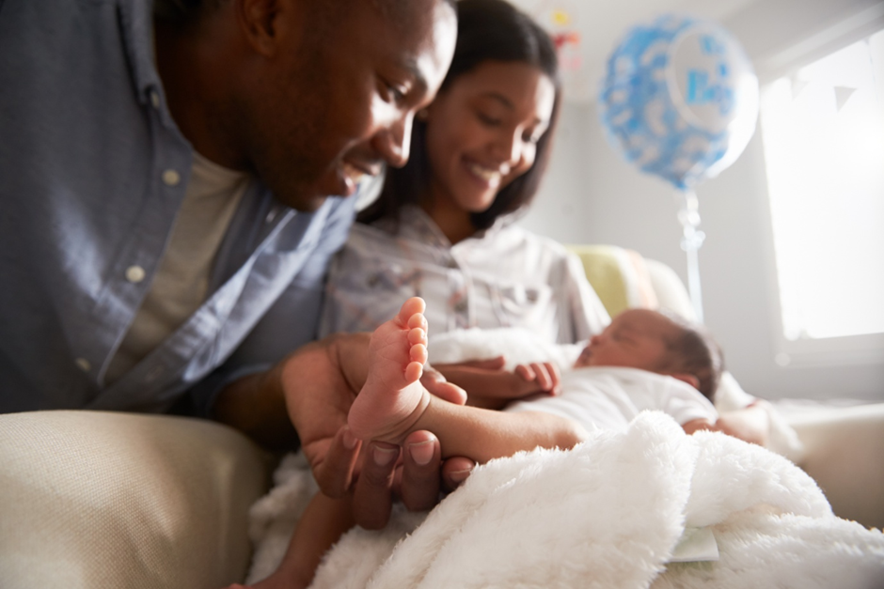
How do Bahá’ís welcome new members?
Notes:
Children in the Bahá’í Faith.
There are no special rituals or ceremonies for Bahá’í children. When a child is born to Bahá’í parents, they may wish to have a “naming day” when they will invite friends and relatives for prayers and celebration.
Picture Attribution to: Image used under license from Shutterstock.com

Slide 25
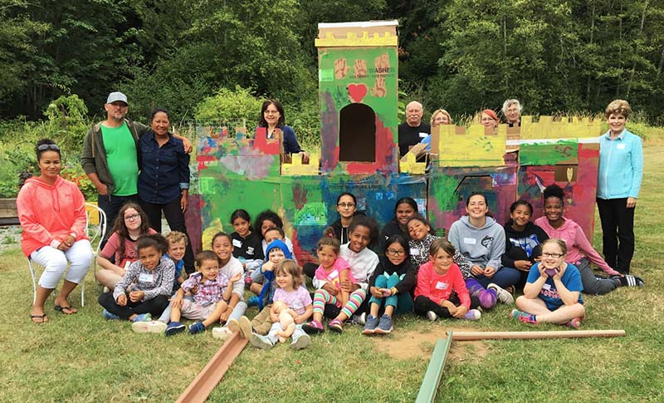
Children
“Every child is potentially the light of the world.”
Bahá’í Writings
Notes:
Bahá’ís believe that “Every child is potentially the light of the world”.
Do you think that light is an important thing to have in the world? Without light we wouldn’t be able to see or do things.
So when Bahá’ís say children could be like the light to the world, it means that children are very important like the light, but they need Spiritual Education to make them shine.
Spiritual Education is learning all the ways we can be loving to ourselves, our family, our friends and the world.
Picture Attribution to: www.bahai.us

Slide 26
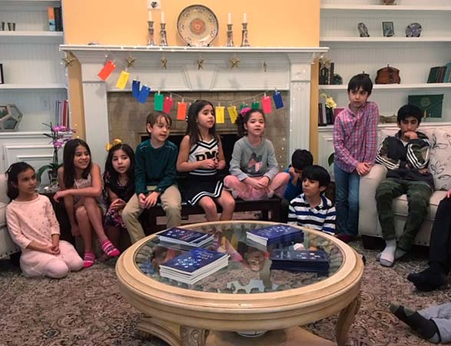
Children’s Classes
Notes:
Bahá’ís have children’s classes to teach children about Spiritual Education. These classes are for all children, not just Bahá’í children.
Children learn about special qualities that are in everyone; such as kindness, honesty, generosity (sharing for example toys, snacks, crayons), patience and many, many more.
Children are also taught about the religions (all the different ways people show they believe in God) of the world so that they can understand and have respect for all of them.
Picture Attribution to: www.bahai.us

Slide 27
  How do Bahá’ís see the world and care for it?
Notes:
Picture Attribution to: https://www.cleanpng.com/png-question-mark-clip-art-question-mark-images-180139/

Slide 28
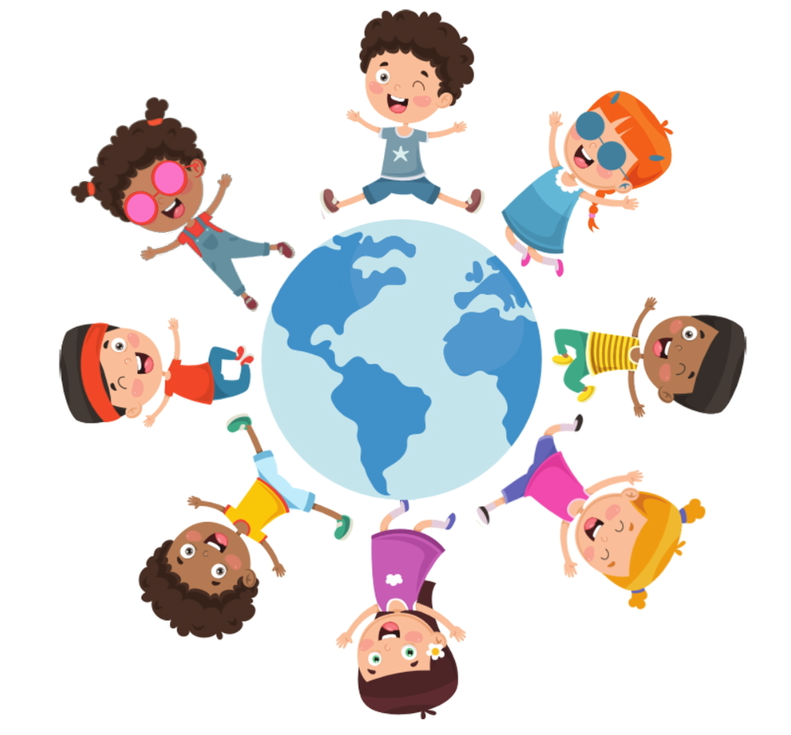
“The earth is but one country and mankind its citizens.” ~ Bahá'u'lláh
For activities press
Notes:
How do Bahá’ís see the world and care for it?
Bahá'u'lláh wanted people to live together in peace. He said “The earth is but one country and mankind its citizens.”
Bahá’ís believe that the earth belongs to everyone. It’s important to show respect to everything and everyone that lives on earth. If people do this, the world will be a happier place.
Teacher reference: Bahá'u'lláh is the Founder of the Bahai Faith
Activity 8: The Earth is But One Country Colouring Sheet
Picture Attribution to: Image used under license from Shutterstock.com

Slide 29
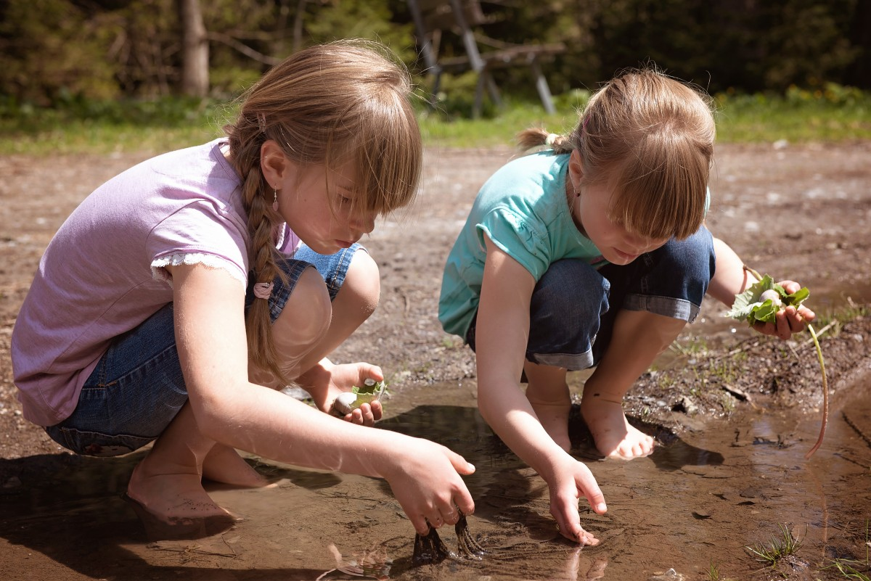
Our Connection to Nature
For activities press
Notes:
Bahá’ís believe that nature should be protected. If the earth belongs to everyone, then people need to work together to take good care of it.
Can you think of different ways you or everyone else can help protect the earth?
Optional link to background music for activities “Happy Earth Day”
https://www.youtube.com/watch?v=tAPBKoIAv1k
Activity 9: Earth Day Craft
See this link: https://www.pinterest.co.uk/pin/47428602314809960/
Activity 10: Earth Day colouring sheet
Activity 11: Create a plant pot out of newspaper and plant a seed in a cup. Let them take it home as a gift. Teachers can add the topic of recycling.
Youtube video: https://www.youtube.com/watch?v=OMo_ytv17Vg
Alternate Activity 12: Create a school/class garden or grow tomatoes in a bag in the classroom as a group project. This links back into the topic of togetherness.

Slide 30
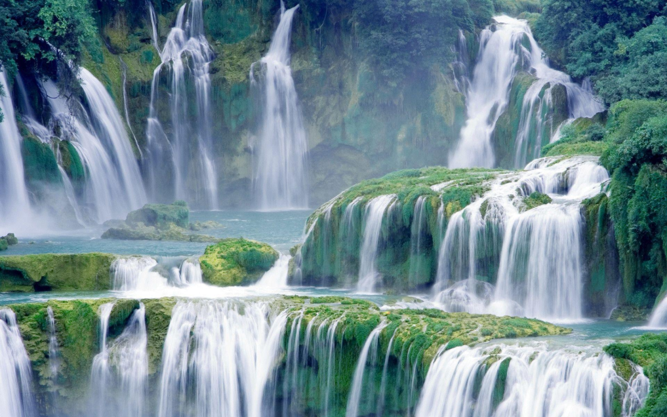
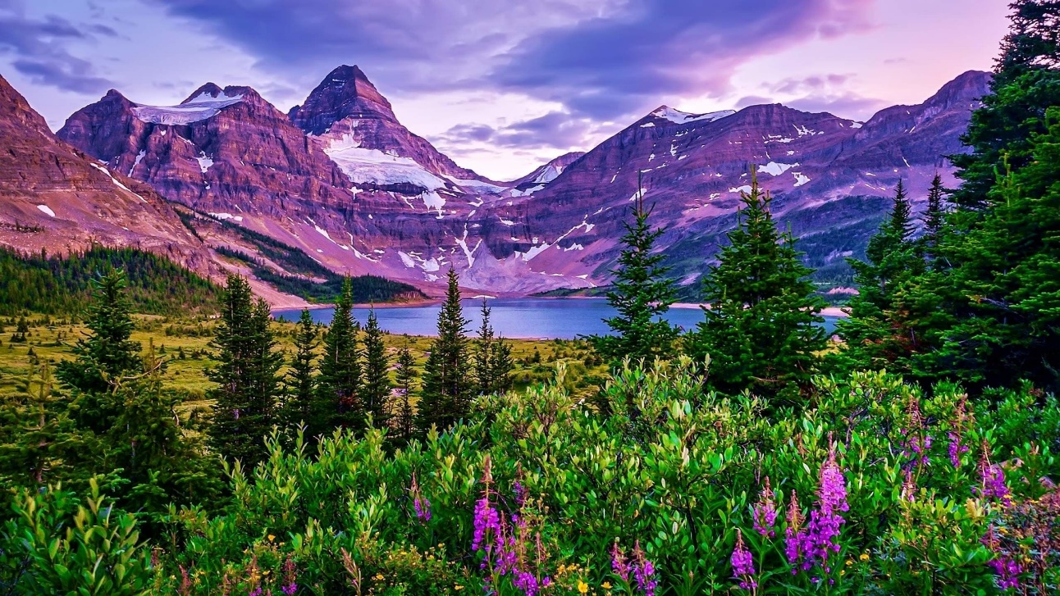
How does nature show the power and beauty of God?
For activities press
Notes:
Context for teachers: Bahá'u'lláh said, “Every time I turn my gaze to Thine earth, I am made to recognize the evidences of Thy power and the tokens of Thy bounty.”
Bahá’ís believe that when they look to nature they can see the qualities of God such as His great power and beauty.
For Power: Explore with the children, why a waterfall is considered powerful. What other types of power do we see in nature? (weather, glaciers, mountains, oceans etc.)
For Beauty: Explore with the children the different colours, textures, sounds, shapes, etc. we can see in nature that are beautiful. (colours in a rainbow, texture of sand or grass, sound of birds chirping or rain falling, shapes of mountains or trees)
Is nature special because people didn’t create it? So if people didn’t create it, do they need to take extra special care of it so they do not lose it?
Optional video of the waterfall: https://www.youtube.com/watch?v=e_HnyYBFxLs
Activity 13: Create a waterfall with paint
See this link: https://teaching2and3yearolds.com/preschool-fine-motor-art/
Activity 14: Beauty means different things to different people. For children this is even more apparent, as what they choose as beautiful can be surprising.
Ask the children to point out things that are beautiful to them. (See worksheet ‘What is Beautiful’ or the ‘What is Beautiful Power Point’) Follow up with having the children draw what is beautiful to them.
Picture Attribution to:
https://wallpapercave.com/waterfall-wallpapers
https://wallpapercave.com/w/wp8292469

Slide 31
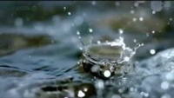
The Beauty and Power of a Waterfall
Notes:
Teacher Note: This video is 2:50 minutes long you can play it for as long as you see suited.
Video Attribution to:
Creator’s name or screen name: Our Planet Earth
Video title: Power of Nature - Water & Waterfalls
Video URL: https://www.youtube.com/watch?v=p0mT1cBwJTU
Publication date: Jun 28, 2015

Slide 32
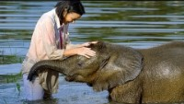
Showing Kindness to Every Creature
Notes:
Context for teachers: Bahá’u’lláh said, “Show forth the utmost loving-kindness to every creature.”
This is a YouTube video of woman that helped an elephant get over his fear of water:
https://www.youtube.com/watch?v=FCuS8H61-sE
Video Attribution to:
Creator’s name or screen name: BBC Earth
Video title: Baby Elephant Overcomes Fear of Water | BBC Earth
Video URL: https://www.youtube.com/watch?v=FCuS8H61-sE
Website name: https://www.bbcstudios.com/
Publication date: Mar 10, 2018

Slide 33
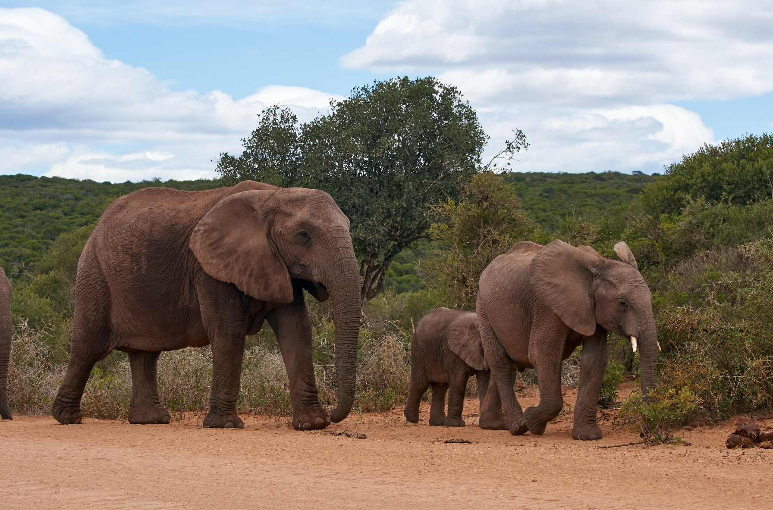
Showing Kindness to Every Creature
For activities press
Notes:
Context for teachers: Bahá’u’lláh said, “Show forth the utmost loving-kindness to every creature.”
Bahá’ís believe that everyone must be fair and just at all times, even to animals. Because animals do not have the power of speech and cannot say when they are mistreated, humans must treat them with even more consideration than people.
Ask children how they think they can help animals? What types of animals would they help?
As citizens/ members of the world, it is everyone’s job to take care of all the creatures of the earth.
Activity 15: Elephant craft See youtube video below
https://www.youtube.com/watch?v=qZ92agnUZjY
Activity 16: Show Kindness to Animals Colouring Sheet
Picture Attribution to: Photo by Wolfgang Hasselmann on Unsplash

Slide 34

The End
Main menu
© Copyright January 2021 Trafford Bahá’í School Committee
Notes:
Picture Attribution to: : Image used under license from Shutterstock.com
© Copyright January 2021 Trafford Bahá’í School Committee

